Slide 1
Presenting the project idea
…The sample slides here are NOT based on IoT projects, so learn the method, but don’t copy…
Sample slides for interview, persona, brainstorming, 2x2 matrix for idea selection, concept sketch

Slide 2
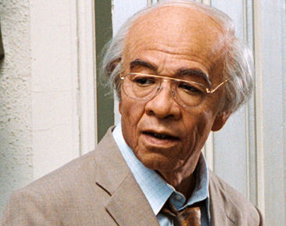
Sample Slide - Interview
- Insights gained through interview.
Insights gained by project group that wants to do something to help improve the lives of elderly people.
When asked what improvements to his living environment he would like to have, Mr Wong mentioned the extension of covered link-ways near his home, and more food stalls and grocery shops.
Currently, many people take the bus to the markets at the town centre. “If you tell an old person to take a bus to the market when he may already have trouble walking, he might give up on the idea and eat bread instead,” he said.
…Easier access to amenities especially food stalls & grocery shops….

Slide 3

Sample Slide - Persona
- Characterisation of a typical end user.
Persona of Mrs. Tan, for whom a group of students will design a low cost “motorised trolley”.
Mrs. Tan is a 35 years old housewife. She enjoys cooking for her family. She walks 10 minutes to the NTUC supermarket near her flat every other day. She normally spends half an hour getting her supply of veggie, meat, fish and fruits. She finds transporting 15kg - plastic bags of food - back a very tiring task.

Slide 4

Sample Slide - Brainstorming
- Generating ideas based on needs of users, whom you have interviewed / observed. Aim for at least 2 ideas per student.
Brainstorming project ideas for students who lunch at poly food-courts.
“Pay as you sit” seats charging
“Happy hours” – cheaper food outside rush hours (LED display project)
Queuing time estimation for each stall
Packaged food vending machine

Slide 5
Sample Slide – 2 x 2 Matrix for Idea Selection
- Selection of one “high impact, high feasibility” idea for implementation.
High Impact
Matrix used to select idea to enhance safety of pedestrians using a zebra crossing.
A
B
Selected for implementation
D
Low Feasibility
High Feasibility
C
Low Impact
A – lights blink at a faster rate when sensor detects a person crossing the road.
B – “reverse horn” – a horn inside the car activated to alert driver if sensor detects a person crossing the road. Wireless transmission from sensor to horn.
C – LED strips on road along zebra crossing.
D – barricade to close road when sensor detects a person crossing the road.

Slide 6
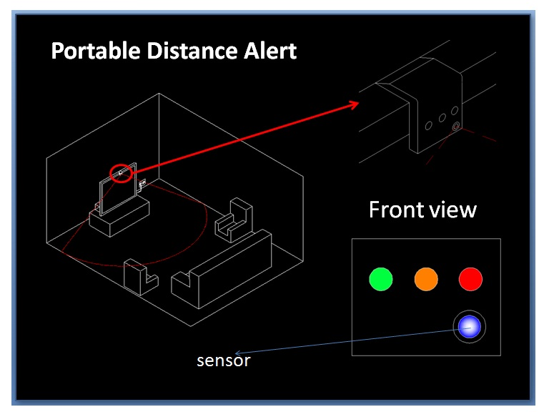
Sample Slide – Concept Sketch
- A simple (hand-drawn) figure to illustrate the concept.
Concept Sketch of a “Portable Distance Alert”, which warns against sitting too close to the TV.

Slide 7
Sample Slide – Block Diagram
Block diagram for implementing a traffic light controller
2 bits
5 bits
Push Buttons
Lights
Controller
14 bits
Traffic Lights
7-Segments
Red Amber Green
Pedestrian Lights
Buzzers
2 bits
Count Down Display

Red man

Green man
Buzzer
Push Button

Slide 8
Sample Slide – Flowchart
Begin
Flowchart for implementing a traffic light controller
On Green TL
On Red Man
Off the rest
On RedTL
On Green Man
Off the rest
Set COUNT to max
Delay
Delay
Traffic Lights
No
Display COUNT
Red Amber Green
Pedestrian Lights
Button
pressed ?
Delay

Yes
Count Down Display
Red man

Green man
On Amber TL
On Red Man
Off the rest
Decrement COUNT
Buzzer
Beep
Delay
Yes
No
Push Button
COUNT
>= 0 ?

Slide 9



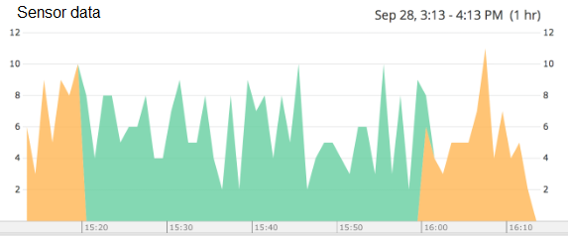

Sample Slide – Dataflow diagram
Dataflow diagram for a Wireless Sensor Network
Sensor nodes
Sensor data,
via BT
Cloud
Data Concentrator
Sensor data,
via various means
Sensor data,
via fibre optics
Supervisor
Alert,
via cellular
Dashboard
Dashboard / UI

Slide 10
Sample Slide – Gantt Chart
Gantt Chart for implementing an IoT project in 4 weeks
Project tasks | Week 14 | Week 15 | Week 16 | Week 17
Assign task to members
Get resources needed (HW, SW etc.)
Set up cloud
Code to read sensor
Code to send data wirelessly
Dev GUI/app
Integration / testing/ debugging

